Slide 1
Exam 70-534 Architecting Microsoft Azure Solutions
#1 Design Azure Resource Manager (ARM) networking (5–10%)
Design Azure virtual networks - Extend on-premises
Describe Azure VPN and Express Route architecture and design
#2 Secure resources (20–25%)
Secure resources by using managed identities
Secure resources by using managed identities
Secure resources by using identity providers
Identify an appropriate data security solution
Design a role-based access control (RBAC) strategy
Manage security risks by using an appropriate security solution
#3 Design an application storage and data access strategy (5–10%)
Design data storage
Select the appropriate storage option
#4 Design advanced applications (20–25%)
Create compute-intensive applications
Create long-running applications
Integrate Azure services in a solution
Implement messaging applications
Implement applications for background processing
Design connectivity for hybrid applications
#5 Design Azure Web and Mobile Apps (5–10%)
Design Web Applications
Design Mobile Applications
#6 Design a management, monitoring, and business continuity strategy (20–25%)
Design a monitoring strategy
Describe Azure business continuity/disaster recovery (BC/DR) capabilities
Design a disaster recovery strategy
Design Azure Automation and PowerShell workflows
Describe the use cases for Azure Automation configuration
#7 Architect an Azure Compute infrastructure (10–15%)
Design ARM Virtual Machines (VMs)
Design ARM template deployment
Design for availability
+ Bonus: Containers
https://www.microsoft.com/learning/en-us/exam-70-534.aspx

Slide 2

Design a Management, Monitoring and Business Continuity Strategy
Monitoring Strategy
BC/DR Capabilities
Design DR Strategy
Azure Automation and PS WF
Automation Use Cases

Slide 3
#6 Design a management, monitoring, and business continuity strategy (20–25%)
1. Design a monitoring strategy {Ian}
Identify the Microsoft products and services for monitoring Azure solutions
leverage the capabilities of Azure Operations Management Suite and Azure Application Insights for monitoring Azure solutions
leverage built-in Azure capabilities
identify third-party monitoring tools, including open source
describe Azure architecture constructs, such as availability sets and update domains, and how they impact a patching strategy
analyze logs by using the Azure Operations Management Suite
2. Design Azure Automation and PowerShell workflows {Ian}
Create a PowerShell script specific to Azure, automate tasks by using the Azure Operations Management Suite
3. Describe Azure business continuity/disaster recovery (BC/DR) capabilities {Dan}
Leverage the architectural capabilities of BC/DR
describe Hyper-V Replica and Azure Site Recovery (ASR)
describe use cases for Hyper-V Replica and ASR
4. Design a disaster recovery strategy {Dan}
Design and deploy Azure Backup and other Microsoft backup solutions for Azure
leverage use cases when StorSimple and System Center Data Protection Manager would be appropriate
design and deploy Azure Site recovery
5. Describe the use cases for Azure Automation configuration {Dan}
Evaluate when to use Azure Automation, Chef, Puppet, PowerShell, or Desired State Configuration (DSC)

Slide 4
What is Business Continuity and Disaster Recovery BC/DR
Business Continuity (BC)
Disaster Recovery (DR)
Planning and preparation to ensure that the business can continue to operate (in a reasonable amount of time) after a disaster or serious business disruptive event.
Preventing or minimizing impact of a disaster or service disruptor event
Key Elements:
Resiliency – Keep running in case of failure
Recover – Recover or restore business functions that fail
Contingency - Plans in place in case an event happens. and is not covered by Resiliency or Recovery.
Business Continuity often deals with more than just technology. (eg. Plan for critical person/people that leave the company). This element not likely on the exam, but it does matter when you architect solutions in real life. If you have read “The Phoenix Project” it would be Brent!
Creating policies and processes to quickly restore services, data, and systems to full functionality
Recovering from a Disaster after it happens. It is often linked to Business Continuity as it is a subset of the Business Continuity plan.
Key Elements:
Availability, High Availability
Urgency to getting systems up and to what % of service.
Cost vs Time vs Risk
Hot/Worm/Cold site
Recovery as a Service (RaaS)
Disaster Recovery as a Service (DRaaS)
Cost to businesses for not doing BC/DR can be catastrophic

Slide 5
Azure BC/DR Capabilities & Use Cases
Hyper-V Replica
Simple, Affordable Second Site
“Extended Replication” + 3rd Party Integration
Hardware Agnostic – either side
Hybrid Cloud
Seamless Integration:
Private Cloud or on-premises to…
Service Provider Cloud
Microsoft Azure
Azure Site Recovery (ASR)
WHEN TO USE: 2nd Site / Use SCCM,SCVMM, Unprotected workloads
WHEN NOT TO USE:
Workload requires synchronous replication, data outside of VHD
Workload needs to recover physical servers, beyond Hyper-V replica’s capabilities

Slide 6
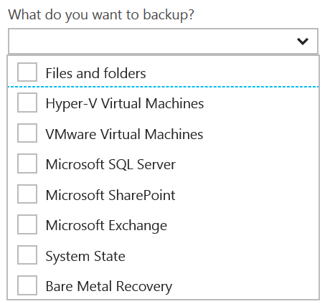
Disaster Recovery Capabilities & Use Cases
Azure Backup
Reliable, Simple, Efficient backup and restore (agent based)
Use for Branch Office or Small Business
Backup and restore files and folders
No Central Management
Azure Backup Server
Disk (D2D), giving high RTOs for tier 1 workloads
Azure (D2D2C) for long term retention
Modern Backup Storage technology (MABS v2)
VMware capabilities
Application Consistency (SQL, Exchange, SharePoint)
No Tape Backup
No Integration with System Center
Requires Azure Subscription
System Center Data Protection Manager (DPM)
Physical, VM, Azure VM
Store Locally to Disks (D2D) and to Tape (D2T)
Store in Azure (D2D2C) for long term retention
Full application consistency across server apps (Exch, SP, SQL…)
Small backup window
Bare Metal Recovery / Recovery to Azure
Full System Center Integration (discovery, reporting, etc)
StorSimple
Proprietary Device | Multiple Tiers
Cloud Integrated Storage (CiS)
Seamless view of ALL Enterprise Storage
Windows and VMWare
Multi-Tiers backup and recovery (Hot/Cold)
Fastest Solution
Long Term Azure storage; scale storage out to Azure
minimize on-premesis disk requirements
Seamless view of ALL Enterprise Storage | Windows and VMWare

Slide 7
Additional Information: SLA for Site Recovery 99.9%
"Failover" is the process of transferring control, either simulated or actual, of a Protected Instance from a primary site to a secondary site.
"On-Premises-to-Azure Failover" is the Failover of a Protected Instance from a non-Azure primary site to an Azure secondary site. Customer may designate a particular Azure datacenter as a secondary site, provided that if Failover to the designated datacenter is not possible, Microsoft may replicate to a different datacenter in the same region.
"On-Premises-to-On-Premises Failover" is the Failover of a Protected Instance from a non-Azure primary site to a non-Azure secondary site.
"Protected Instance" refers to a virtual or physical machine configured for replication by the Site Recovery Service from a primary site to a secondary site. Protected Instances are enumerated in the Protected Items tab in the Recovery Services section of the Management Portal.

Slide 8
RPO “Recover Point Objective” & RTO “Recover Time Objective are time intervals, typically expressed in number of hours
RPO is the maximum targeted time that data can be lost (in time)—it is the amount of time between backup, replication, or synchronization. It answers the question, “What is an acceptable amount of data loss?” It is usually much smaller than RTO.
RTO is how long it takes (in time) to restore services after a disaster. It answers the question, “How long will it take to get service back up?”

Slide 9
An asynchronous operation is one that transpires sequentially: first one action, and then another. The operations do not take place simultaneously. This type of processing means that there is a time gap between the first operation and the second. An example would be writing data to primary and secondary storage. First data is written to the primary; data destined for the secondary is queued and must wait until the write operation to the primary is complete.

Slide 10
Synchronous means that operations are carried out at the same time (think of this as parallel processing). With this type of processing, there is no time gap between the first process and the second process. Both operations take place simultaneously.

Slide 11
Sharding is when you split a database and partition the different parts of the database across multiple drives. A shard is a single horizontal partition of the database.

Slide 12
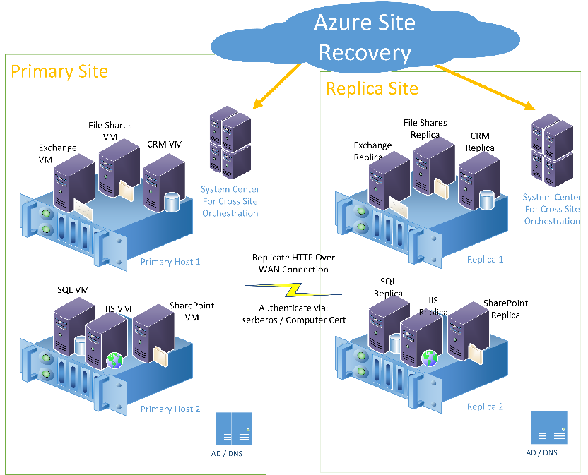
6-8 Site Recovery primary site and replica site
Azure Site Recovery monitoring a primary and replica site. The sites have workloads such as Exchange, CRM, IIS, SQL, and SharePoint running on hosts. Azure Site Recovery communication goes through System Center. System Center actually performs the orchestration of the cutover

Slide 13


StorSimple architecture: A new approach
StorSimple Cloud Appliance
Azure
Applications
Microsoft Azure
Periodic VSS consistent cloud snapshots of production data
Internet
Internet
Customer datacenter
Remote/branch offices
Hyper-V
Hyper-V
SAN
Linux
Linux
SAN
NAS
StorSimple Physical Array
VMware
StorSimple Virtual Array
VMware
Notes:
This slide puts it all the solution components together : StorSimple is an easy way to connect any server on any Hypervisor environment – including Hyper-V, Linux, or VMware - to the cloud….with no app modification.
Further, as you can see, we now have the flexibility of configuring StorSimple as a SAN or a NAS device in the customer environment (replacing traditional SAN & NAS devices). i.e. To a customer, it looks like a SAN or a NAS device – with the added advantage of being able to connect to the cloud. And cloud is what brings all the unique differentiators to the StorSimple solution : including …auto tiering, cloud based data protection, and DR. This is huge – because now customers are able to combine several heterogeneous pieces of traditional storage solutions (like tape, archival, back-up & restore) into one elegant solution – with a single management console. StorSimple Manager provides a single view & management capabilities for both physical and virtual arrays, as well as StorSimple Cloud Appliance. In addition, StorSimple can be further enhanced for scenarios like enterprise collaboration with our partners like Talon, and video surveillance with MileStone.

Slide 14
How StorSimple works
Enables data mobility between your datacenter and the cloud
StorSimple tiers data
moving aging, less accessed data to the cloud, at lower costs
rather than keeping it with your mission-critical data in your datacenter (or at some remote location).
However, the data in the cloud is still safe and reliably accessible.
This results in:
Lower total storage costs by up to 60%
Improve data protection
Increase storage agility
Enable virtually bottomless storage
Notes:
This slide puts it all the solution components together : StorSimple is an easy way to connect any server on any Hypervisor environment – including Hyper-V, Linux, or VMware - to the cloud….with no app modification.
Further, as you can see, we now have the flexibility of configuring StorSimple as a SAN or a NAS device in the customer environment (replacing traditional SAN & NAS devices). i.e. To a customer, it looks like a SAN or a NAS device – with the added advantage of being able to connect to the cloud. And cloud is what brings all the unique differentiators to the StorSimple solution : including …auto tiering, cloud based data protection, and DR. This is huge – because now customers are able to combine several heterogeneous pieces of traditional storage solutions (like tape, archival, back-up & restore) into one elegant solution – with a single management console. StorSimple Manager provides a single view & management capabilities for both physical and virtual arrays, as well as StorSimple Cloud Appliance. In addition, StorSimple can be further enhanced for scenarios like enterprise collaboration with our partners like Talon, and video surveillance with MileStone.

Slide 15
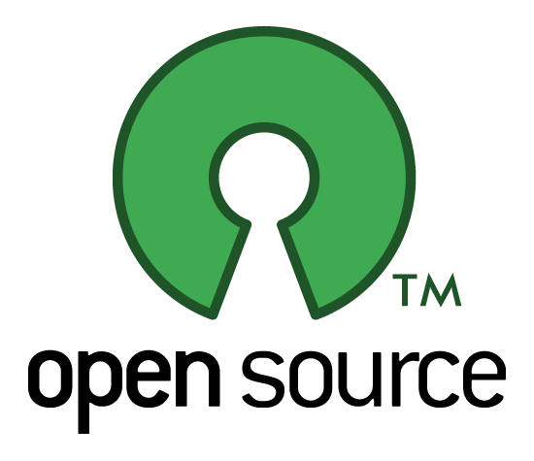
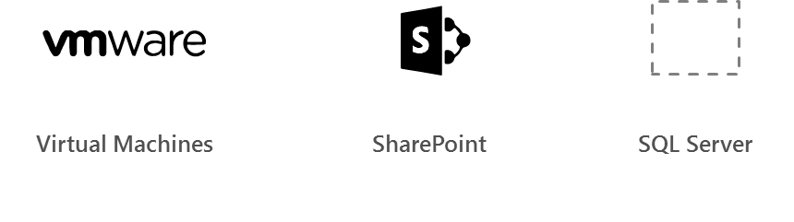
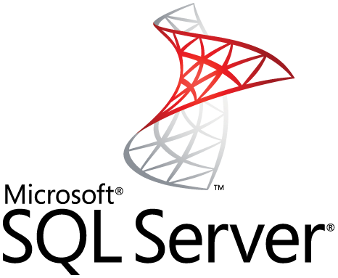
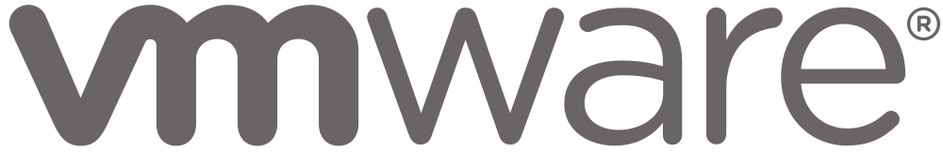
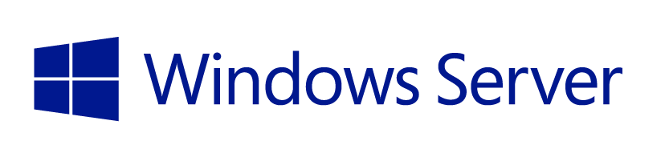
Supported workloads
How customers benefit
Infrastructure on-demand workloads
DR
Search / Data mining
Dev / Test
Cloud apps
Capacity driven workloads
Traditional on-premises workloads
File shares
Collaboration
Archives
VM workloads
SharePoint
SQL Server
Notes:
This slide is shows the alignment of different workloads with different capabilities / configurations of StorSimple solution.
For large, unstructured, capacity driven data-sets, use tiered volumes for cloud storage
For performance driven workloads – use local volumes as a local storage.
For on-demand infra requirements like DR, and dev-test, use the StorSimple Cloud Appliance
So what does all these enhancements mean for partners?

Slide 16
Integrated data protection and DR
How customers benefit
Largescale, on-demand capacity for data protection
Location independence for disaster recovery
Shortened RTO for data availability for apps
No purchases, upgrades and maintenance for backups and tapes
Capability to test and validate DR
DR automation and single-click orchestration
StorSimple Cloud Appliance
Azure
Applications
Microsoft Azure
Periodic VSS consistent cloud snapshots of production data
Data Center 1
Data Center 2
DR
Production data
Production data

Slide 17
Test, validate, and accelerate DR
How customers benefit
Cloud Backup (target for backup software) With 100 Mbps WAN Link
StorSimple ‘instant recovery’
= faster RTO than tapes
and cloud gateway backups
90 Days
30 Days
Tape
7 Days
RTO is independent of volume sizes
>100x faster than tapes and regular cloud backup
Off-site Backups
1 Day
StorSimple Cloud Snapshots with 50 Mbps WAN link
1 Hour
15 Min.
1 TB
5 TB
20 TB
50 TB
100 TB
Primary Data

Slide 18
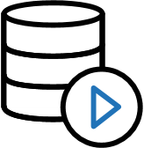
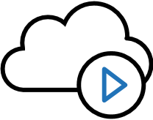
Focus on business outcomes
How customers benefit
On-demand storage
On-demand services in Azure
Consolidated management
Highly scalable, cost-effective and secure data storage. No need for incessant planning, upgrade and maintenance
Cloud provides IaaS to deploy applications that use StorSimple data in the cloud. No long lead times for new business projects
No need to manage separate data protection solutions or be on-site. Up-to-the-minute status and consistent control in all sites

Slide 19
Replicate Hyper-V virtual machines (without VMM) to Azure using Azure Site Recovery with the Azure portal
Hands-On:
https://docs.microsoft.com/en-us/azure/site-recovery/site-recovery-hyper-v-site-to-azure

Slide 20
Replicate physical machines to Azure by using Site Recovery
Hands-On:
https://docs.microsoft.com/en-us/azure/site-recovery/site-recovery-physical-servers-to-azure

Slide 21
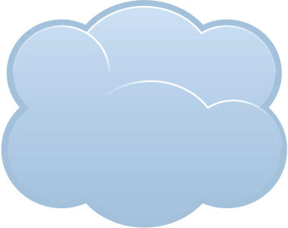


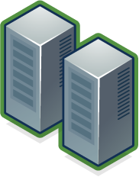
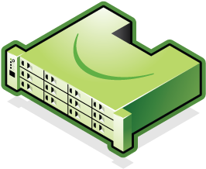
Cloud Snapshots Provide Rapid Recovery
Cloud
Snapshots
Production Data
Production Data
Enterprise Data Center 1
Enterprise Data Center 2
Connect many servers to cloud storage and scale data sets with StorSimple solution
Rapidly recover to any data center (location independent) via mounting the cloud
Notes:
Slide Objective: Discuss rapid recovery capabilities provided by StorSimple in the event of a datacenter outage.

Slide 22
EXAM TIP!
StorSimple uses iSCSI protocol to link data storage. This means that the storage that is in Azure is presented as locally attached iSCSI volumes.

Slide 23
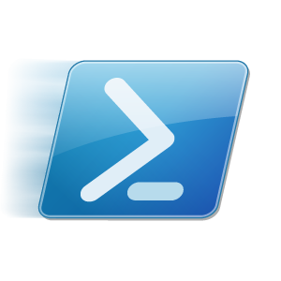
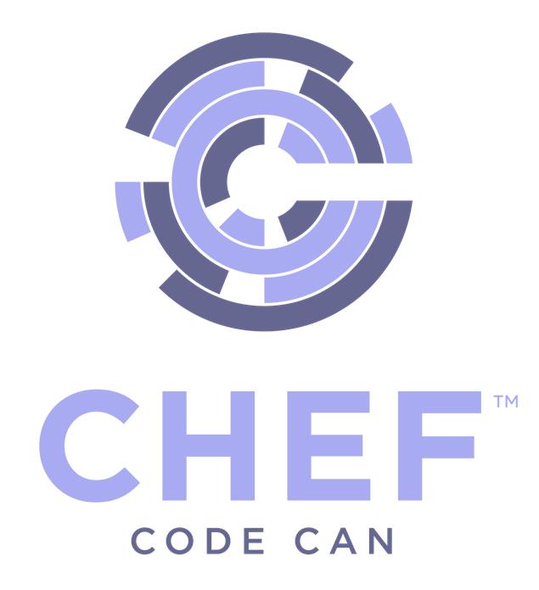
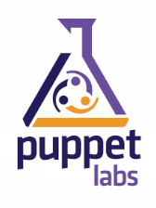
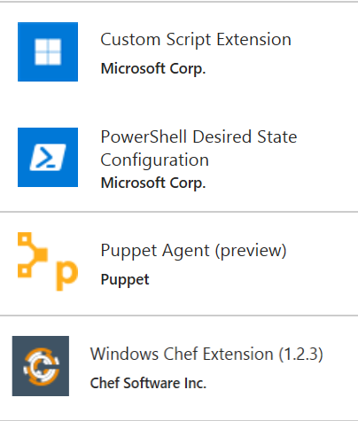
Azure Automation
Azure Automation
Runbooks
Chef Configure and Automate. Apply Fine Grained Permissions
https://www.chef.io/solutions/windows/
Puppet Can Configure and Manage Windows and Azure
http://puppetlabs.com/solutions/microsoft
Desired State Configuration
Make it So https://docs.microsoft.com/en-us/azure/automation/automation-dsc-overview
Many More..
In the portal + New – Azure Automation
DevOps Enabler

Slide 24
Why Azure Automation
Simplify cloud management with process automation
Save time and money with automation
Eliminate time-consuming, repetitive tasks
Eliminate human mistakes
Improve reliability, efficiency and speed
Use with Azure and partner cloud services
Integrate with any service using PowerShell scripts
Get a highly-available automation engine
Lower Operating Costs

Slide 25
Azure Automation Use Cases
Monitoring Configurations
Eliminate Configuration Drift
Automated Change of Configuration
Maintain Exact Configuration (override other changes)
Automated Testing
Automating Usage – Auto Start – Auto Stop
Automating Hybrid Scenarios
Automated Deployment
Enable DevOps practices

Slide 26
Azure Automation Runbooks
Introduction: https://docs.microsoft.com/en-us/azure/automation/automation-intro
Based on Windows PowerShell or Windows PowerShell Workflow, so they do anything PowerShell can do
Can work with application or service API’s
Use PowerShell Modules
Can access any cloud resources
Hybrid Runbook Worker an run in your local datacenter and manage local resources. https://docs.microsoft.com/en-us/azure/automation/automation-hybrid-runbook-worker
Learning PowerShell Workflow Concepts for Automation runbooks https://docs.microsoft.com/en-us/azure/automation/automation-powershell-workflow

Slide 27
PowerShell Runbooks vs Workflows
PowerShell runbooks have the same lifecycle, capabilities, and management as PowerShell Workflow runbooks but there are some differences and limitations:+
PowerShell runbooks run fast compared to PowerShell Workflow runbooks as they don’t have compilation step.
PowerShell Workflow runbooks support checkpoints, using checkpoints, PowerShell Workflow runbooks can resume from any point in the runbook whereas PowerShell runbooks can only resume from the beginning.
PowerShell Workflow runbooks support parallel and serial execution whereas PowerShell runbooks can only execute commands serially.
In a PowerShell Workflow runbook, an activity, a command, or a script block can have its own runspace whereas in a PowerShell runbook, everything in a script runs in a single runspace.
Some syntactic differences between a native PowerShell runbook and a PowerShell Workflow runbook. https://technet.microsoft.com/en-us/library/dn151046.aspx

Slide 28
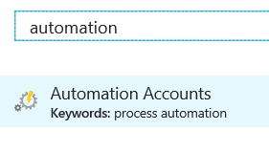
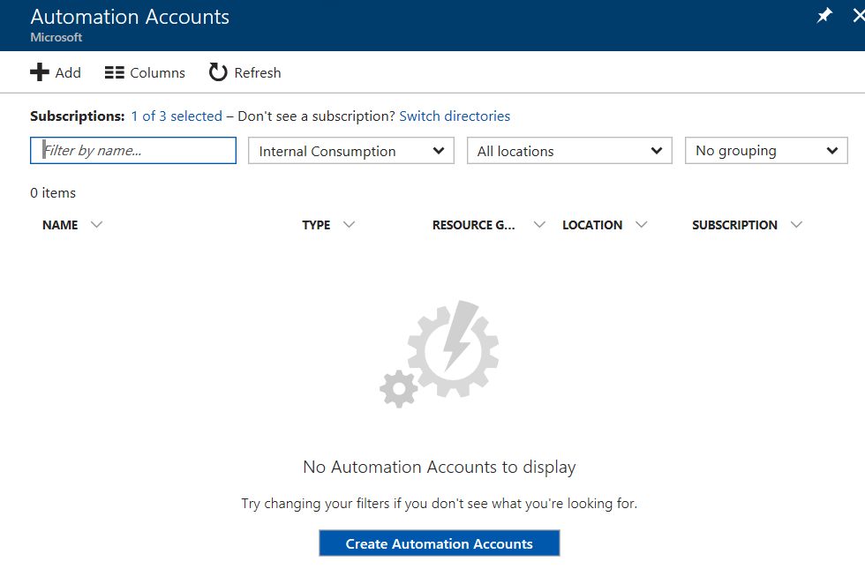
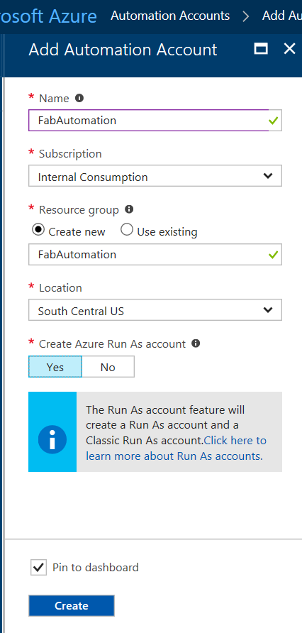
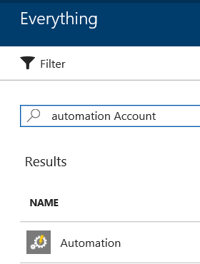
Demo
Add
Azure
Automation
Account

Slide 29
Lab
My first graphical runbook
https://docs.microsoft.com/en-us/azure/automation/automation-first-runbook-graphical
My first PowerShell runbook
https://docs.microsoft.com/en-us/azure/automation/automation-first-runbook-textual-powershell
My first PowerShell Workflow runbook
https://docs.microsoft.com/en-us/azure/automation/automation-first-runbook-textual

Slide 30
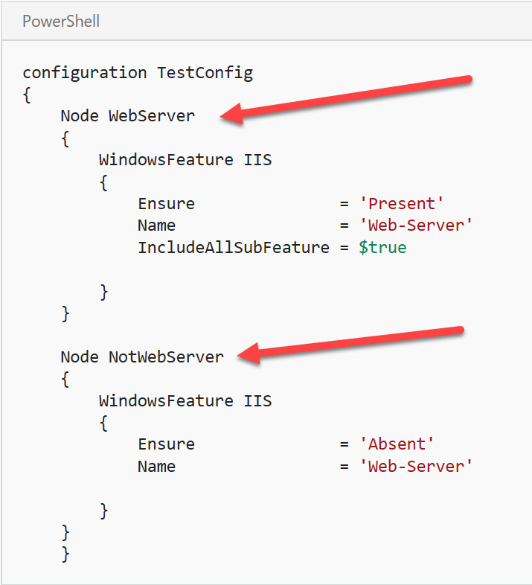
Lab Getting Started with Azure Automation DSC Desired State Configuration (DSC) {Make it So}
Prerequisites
Creating a DSC configuration
Importing a configuration into Azure Automation
Viewing a configuration in Azure Automation
Compiling a configuration in Azure Automation
Viewing a compilation job
Viewing node configurations
Onboarding an Azure VM for management with Azure Automation DSC
Viewing the list of DSC nodes
Viewing reports for DSC nodes
Reassigning a node to a different node configuration
Unregistering a node
Related Articles
DSC Overview:
https://docs.microsoft.com/en-us/azure/automation/automation-dsc-overview
Lab: https://docs.microsoft.com/en-us/azure/automation/automation-dsc-getting-started

Slide 31

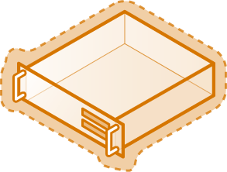
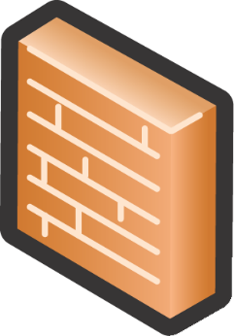
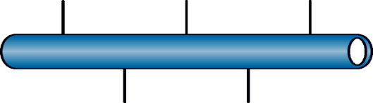
Azure Infrastructure Services
Load-Balanced Set
Cloud Service
Endpoint
VM & Data Disks
Private port
Public port
Availability Set
AutoScaling
DIP
Incoming Requests
DIP
…
Regional Vnet
VIP
Load
Balancer
DIP
DNS
DIP
Site-to-Site gateway
Point-to-Site
gateway
VIP - Public IP assigned by Azure and bound to a cloud service
DIP – Internal IP assigned by Azure to the vNIC of a VM via DHCP
Endpoint – a pair of a public port and a private port for communicating with a cloud service
Notes:
© 2014 Yung Chou.

Slide 32
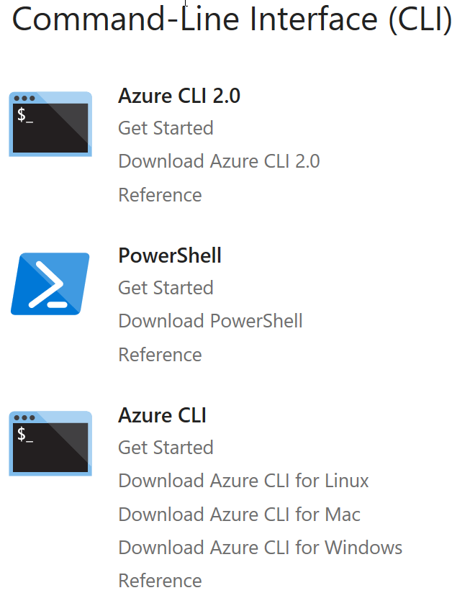
PowerShell
Getting Started with Azure
Need help with PowerShell? If you are unfamiliar with PowerShell, see Scripting with PowerShell. https://technet.microsoft.com/en-us/library/bb978526.aspx
Review the Install article to get Azure PowerShell running https://docs.microsoft.com/en-us/powershell/azure/install-azurerm-ps. Using PowerShellGet requires an Execution Policy that allows you to run scripts. For more information about PowerShell's Execution Policy, see About Execution Policies.
Get-Module PowerShellGet -list | Select-Object Name,Version,Path # If you do not have PowerShellGet installed, you will need to install the latest version of WMF
Install the Azure Resource Manager modules from the PowerShell Gallery
Install-Module AzureRM –AllowClobber # Reply Y to trust the PSGallery (Requires Elevation)
Import-Module AzureRM # Does not require elevation
List other available AzureRM modules
Get-Module -ListAvailable AzureRM
Login to Azure
Login-AzureRmAccount
Get-AzureAccount # List my Azure Accounts
Get-AzureSubscription
Set the Default Subscription
Set-AzureRmContext -SubscriptionID <subscriptionId>
https://docs.microsoft.com/en-us/azure/#pivot=sdkstools

Slide 33
PowerShell Working with a VM using RM --- NEED TO UPDATE TO RM
Get-AzureVM List Azure VM’s.
Create a new VM:
New-AzureVMConfig Creates a new VM configuration object. You can then use this object to perform a new deployment as well as to add a new VM to an existing deployment.
Add-AzureProvisioningConfig Adds the provisioning configuration to an Azure VM.
Set-AzureSubnet Sets the subnet list for a VM configuration.
New-AzureVM Adds a new VM to an existing Azure service, or creates a new VM and service in the current subscription if either the -Location or -AffinityGroup is specified.
Example:
New-AzureVMConfig -Name <VmName> -InstanceSize Small –ImageName <ImageNameVHDString> ` | Add-AzureProvisioningConfig –Windows –Password <adminPassword> -AdminUsername <adminusername> ` | Set-AzureSubnet 'AD-Production' ` | New-AzureVM –ServiceName <MyServiceName> -VNetName <MyNetworkName>
Remove-AzureVM Removes an Azure VM (Note this command provides a -DeleteVHD switch to also remove the underlying disks when you remove the AzureVM) .
Restart-AzureVM Restarts an Azure VM.
Start-AzureVM Requests the start of an Azure VM.
Stop-AzureVM Requests a shutdown of a VM (includes deallocate d status unless -StayProvisioned parameter is passed).
Update-AzureVM Accepts update information for the specified VM and initiates the update. You can add or remove data drives, modify the cache mode of data or operating system disks, change the network endpoints, or change the size of the VM.
You can use “VM Name” or VM.Object in all scripts; for example
Restart-AzureVM [-Name] <String> [-ServiceName] <String> [<CommonParameters>]
or:
Restart-AzureVM -VM <PersistentVM> [-ServiceName] <String> [<CommonParameters>]
Add-AzureVhd Uploads a VHD to Azure (as a fixed drive) and converts from dynamic to fixed.
Get-AzureDisk [[-DriveName] <String>] [<CommonParameters>] Get a particular drive with which to work.
Add-AzureDisk Adds a new drive to the Microsoft Azure drive repository in the current subscription. This drive is bootable if you specify the optional -OS parameter. If you don’t specify it, the drive is a data drive. The required parameters are DiskName and MediaLocation.
Add-AzureDataDisk Adds a new data drive to a VM object. Use the -CreateNew parameter to create a new data drive with a specified size and label, and then attach it. Use the -Import parameter to attach an existing drive from the image repository. Use the -ImportFrom parameter to attach an existing drive from a Blob in a storage account. Using this cmdlet, you can specify the host-cache mode of attached data drives.
Author: What is this? To what is it referring? This is kind of coming from out of the blue, so I think we need some more description here.
done
Author: Is this part of the command? Should it be in italic?
No, there is not a deallocation command. Deallocation is a status.

Slide 34
PowerShell Working with a VM using ARM

Slide 35
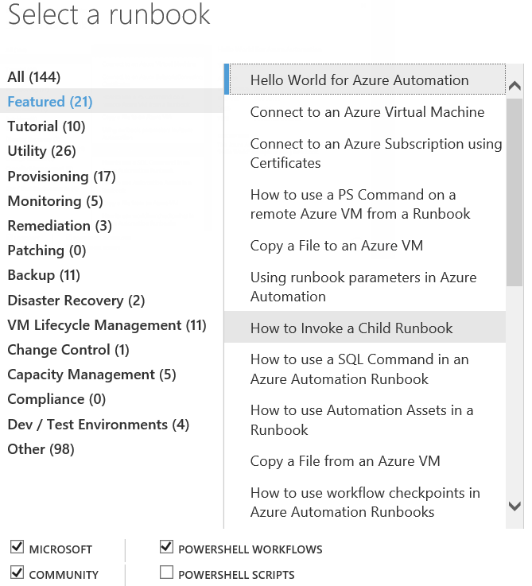
PowerShell Runbooks

Slide 36
6.1 Summary
System Center is made up of many components that can help you to manage, monitor, orchestrate, and protect systems.
Designing solutions for a hybrid scenario can save time and money while simplifying and automating IT tasks
The larger an enterprise, the more likely it needs automation, management, monitoring, and protection. However, the tools and use cases for hybrid scenarios are relevant for any size of business .
“size of business”? “business size”?
No clue?

Slide 37
Azure Backup Key Workloads
Specialized Workloads
File/Folders/Volumes
Virtual Machines
Exchange
SharePoint
SQL Server
Windows Server
Windows
Windows
Linux
Hyper-V
Windows Server
Microsoft Azure
VMware
Notes:
1.
Workload: Files and folders
Source Machine: Windows Server or Windows Client
Azure Backup Solutions:
Azure Backup agent,
System Center DPM (+ the Azure Backup agent),
Azure Backup Server (includes the Azure Backup agent)
2.
Workload: Hyper-V virtual machine (Win & Linux), VMWare Virtual Machine (Win & Linux), Microsoft SQL Server, Microsoft SharePoint, Microsoft Exchange
Source Machine: Windows Server
Azure Backup Solution: System Center DPM (+ the Azure Backup agent); Azure Backup Server (includes the Azure Backup agent)
3.
Workload: Azure IaaS VMs (Windows) and Azure IaaS VMs (Linux)
Source Machine: N/A
Azure Backup Solution: Azure Backup (VM extension)

Slide 38
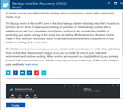
How It Works: Azure Backup Server
2. Register and configure Vault
1. Create Backup and Site Recovery Vault
3. Install Azure Backup Server software
4. Schedule & Back up encrypted data
Azure Backup Windows Server/Client
5. Recover to the same or a different server; On-Premisis or Azure VM
Step-By-Step
https://docs.microsoft.com/en-us/azure/backup/backup-try-azure-backup-in-10-mins
Notes:
Sign Up at the Azure portal
Install Azure Backup Server software
Register and configure
Back up encrypted data
Anytime the data leaves your boundary, it is encrypted. You have the passwords and keys and it’s always restored in Azure.
Recover to the same or a different server

Slide 39
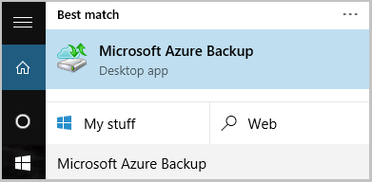
Name of the Backup agent Installer is:
MARSagentinstaller.exe
Backup Agent is
Microsoft Azure Backup
"C:\Program Files\Microsoft Azure Recovery Services Agent\bin\wabadmin.msc"
Maximum rate of backups per day?
Three (3) times per day!

Slide 40
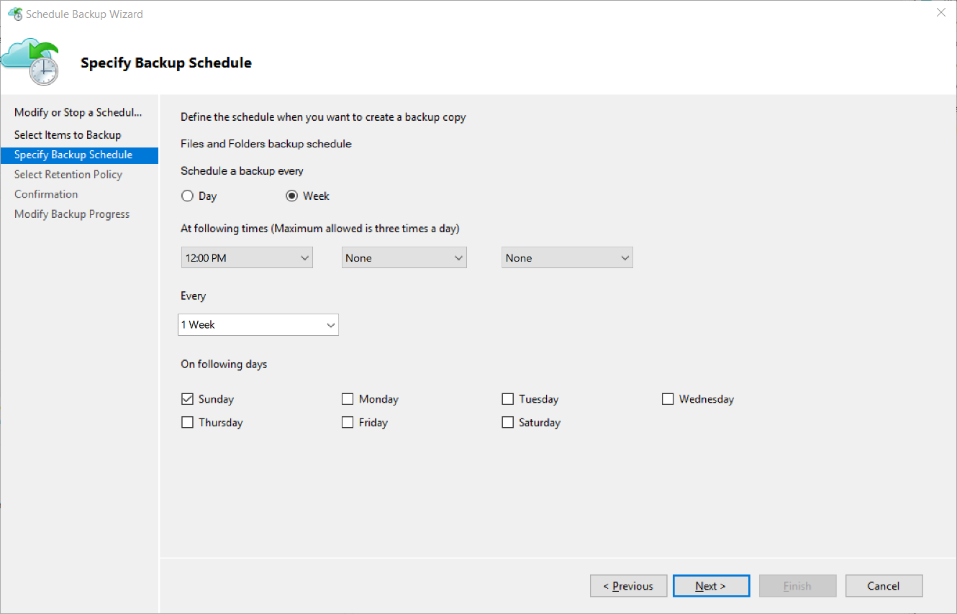
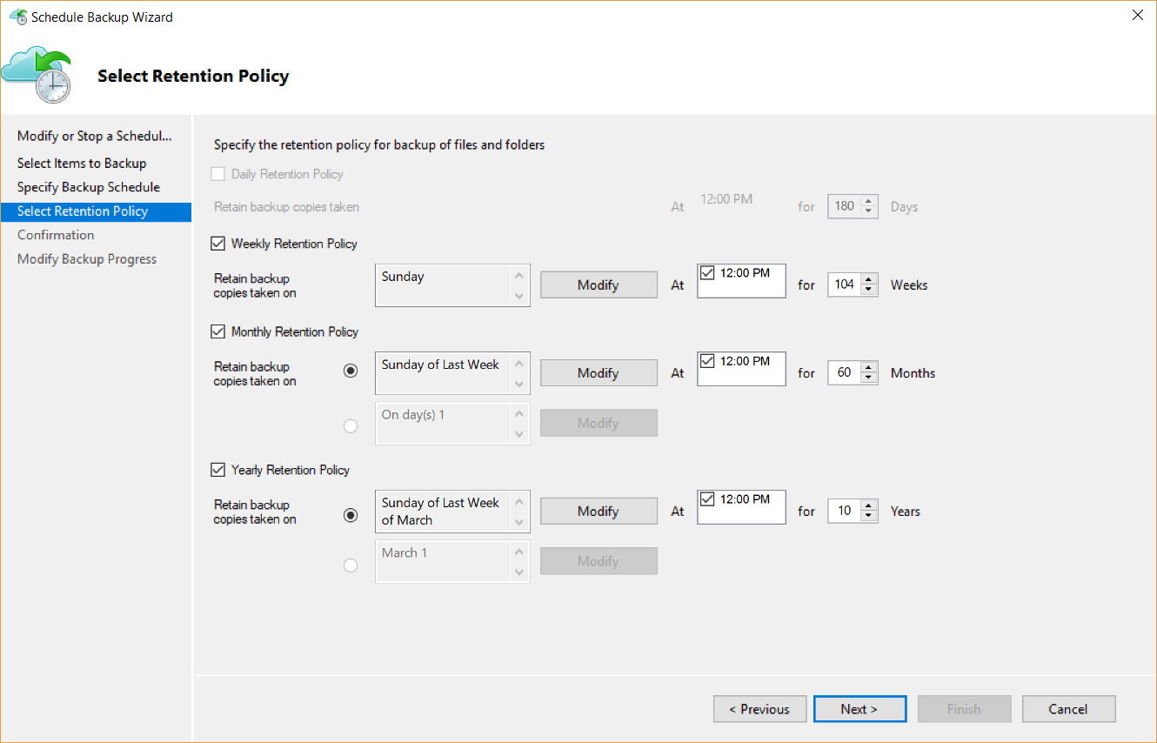
Backup Schedule & Retention Policy
Backup Schedule
Retention Policy

Slide 41
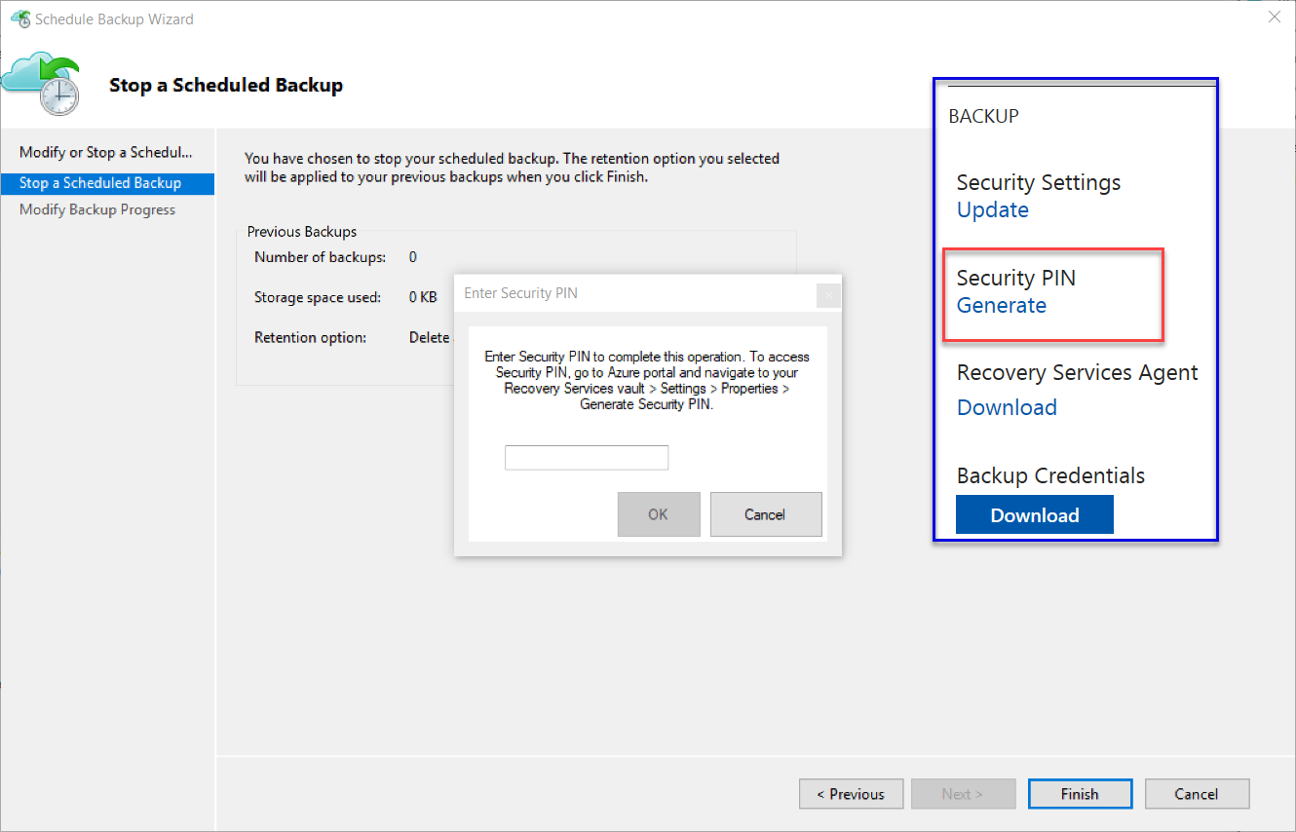
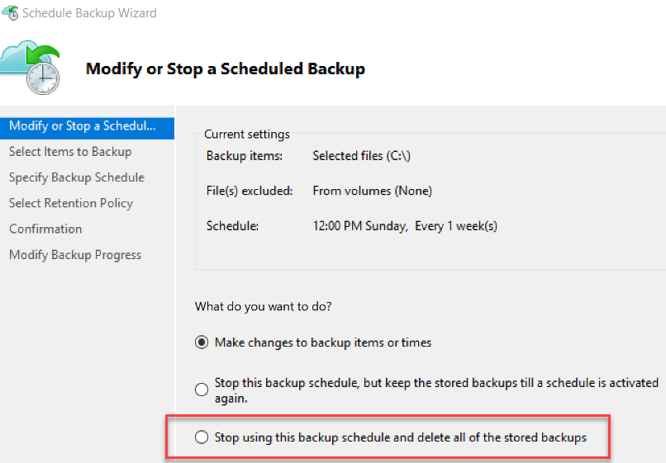
Cancelling Schedule and Removing Backups

Slide 42
Microsoft Azure Backup Server v2
Protect application workloads:
Hyper-V VMs, Microsoft SQL Server, SharePoint Server, Microsoft Exchange and Windows clients
Backup To:
Disk (D2D), giving high RTOs for tier 1 workloads
Azure (D2D2C) for long term retention
Modern Backup Storage technology (MABS v2) store backups:
Using Resilient File System (ReFS) block-cloning technology to store incremental backups,
MABS v2 significantly improves storage usage and performance.
Note: VMware is supported only in testing if Azure Backup Server is deployed on Windows 2016
Microsoft Azure Backup Server (MABS) Deployment:
physical standalone server.
Hyper-V virtual machine
Windows virtual machine in VMWare
Physical standalone server
Hyper-V virtual machine
Windows virtual machine in VMWare
An Azure virtual machine - back up cloud workloads running as Azure virtual machines.
Disks for backup storage pool: 1.5 times size of data to be protected
Docs: https://azure.microsoft.com/en-us/blog/announcing-microsoft-azure-backup-server/
Download: https://www.microsoft.com/en-us/download/details.aspx?id=55269

Slide 43
Documentation / More Info…
Azure Key Vault:
https://docs.microsoft.com/en-us/azure/key-vault/
Azure Backup:
https://docs.microsoft.com/en-us/azure/backup/

Slide 44
When you create a recovery vault for Backup, use a different region than that of the servers and services you will be backing up. This will provide a level of protection against a regional disaster such as the failure of an Azure datacenter or hurricane that can take out an entire region including your on-premises datacenter.
Backup imposes a limit of 1,700 GB of data per volume that that you can back up in one backup operation
Limit of 366 Restore Points
Almost 10 years of retention (3,360 days / 9.2 years)

Slide 45
More Tools + 3rd Party Tools --- Many
Most Backup Solutions will now backup to Azure; Including:
3rd Party
Microsoft
Veeam Backup – Restore Directly to Azure; Many workloads including SharePoint, AD, Exchange, Files, SQL…
NetBackup
Veritas
Acronis
CommVault
More…
Microsoft® SQL Server® Backup to Microsoft Azure®Tool https://www.microsoft.com/en-us/download/details.aspx?id=40740
AZCopy https://docs.microsoft.com/en-us/azure/storage/storage-use-azcopy

Slide 46
Lab: Step-By-Step
Create a recovery services vault
Configure the vault
Install and register the agent
Back up your files and folders
Questions?
Next steps
https://docs.microsoft.com/en-us/azure/backup/backup-try-azure-backup-in-10-mins

Slide 47
Backup" or "Back Up" is the process of copying computer data from a registered server to a Backup Vault.
"Backup Agent" refers to the software installed on a registered server that enables the registered server to Back Up or Restore one or more Protected Items.
"Backup Vault" refers to a container in which Customer may register one or more Protected Items for Backup.
"Failure" means that either the Backup Agent or the Service fails to fully complete a properly configured Backup or Recovery operation due to unavailability of the Backup Service.
"Protected Item" refers to a collection of data, such as a volume, database, or virtual machine that has been scheduled for Backup to the Backup Service such that it is enumerated as a Protected Item in the Protected Items tab in the Recovery Services section of the Management Portal.
"Recovery" or "Restore" is the process of restoring computer data from a Backup Vault to a registered server.

Slide 48
AzureRM.RecoveryServices.Backup (PowerShell)
https://docs.microsoft.com/en-us/azure/backup/backup-azure-vms-automation
Need to read and understand.
Use as Lab

Slide 49
Data Protection Manager & Azure Backup
DPM will backup more workloads
SQL, Exchange, SharePoint
DPM is deployed on-premises as a physical server or virtual machine—If you deploy DPM as a physical server or as an on-premises Hyper-V virtual machine you can back up data with Azure Backup in addition to backing data up to disk and tape.
Azure Backup provides a simple method of offsite storage. You can store data with Azure up to 3360 days
DPM is deployed as a virtual machine in Azure—If DPM is deployed as an Azure virtual machine (possible from System Center 2012 R2 with Update 3) you can back up data to Azure disks attached to the DPM Azure virtual machine and then offload data storage with backup to Azure Backup.
You can offload storage to Azure Backup from the Azure disk, allowing you to scale up by storing older data in Azure Backup and new data on disk
https://technet.microsoft.com/en-us/library/jj728752(v=sc.12).aspx

Slide 50
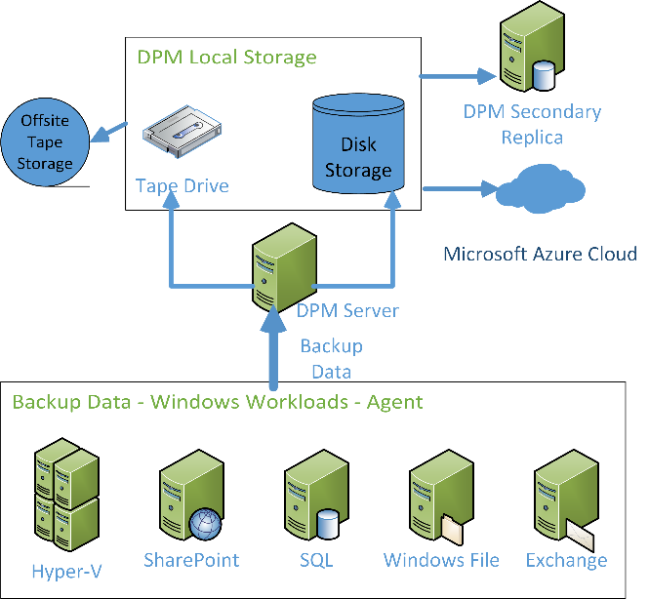
DPM Architecture
Data Protection Manager backing up Microsoft workloads and sending that data through the Data Protection Manager server to local storage and tape, the tape is being sent offsite. Data is also being sent to a Data Protection Manager Secondary Replica and to Microsoft Azure.

Slide 51
READ & Practice https://docs.microsoft.com/pdfstore/en-us/Azure.azure-documents/live/backup.pdf
Link from https://docs.microsoft.com/en-us/azure/backup/backup-try-azure-backup-in-10-mins – Download PDF

Slide 52
EXAM TIP!
In the Azure PowerShell command, OB stands for Online Backup. If you get an Azure PowerShell exam question on backup, make sure that your answer is using the Online Backup or OB version of the command; for example:
Get-OBPolicy retrieves the current backup policy, which includes the schedule.
Start-OBBackup –Policy $policy –Force executes a Backup Now.
To run Azure PowerShell modules for Online Backup, you must be running with Administrative permissions (elevated).

Slide 53
6.1.0 Which of the following is NOT part of the Azure Monitoring Strategy?
Automated System Recovery (ASR)
Systems Center Operations Manager (SCOM)
Management Pack for Windows Azure
Desired State Configuration (DSC)
Global Service Manager (GSM)
Automated System Recovery (ASR)
Systems Center Operations Manager (SCOM)
Management Pack for Windows Azure
Desired State Configuration (DSC)
Global Service Manager (GSM)

Slide 54
6.1.1 Which System Center components have direct integration with Azure? (Choose all that apply.)
Operations Manager
Confi guration Manager
Virtual Machine Manager
Orchestrator
Data Protection Manager
Service Manager
App Controller
Endpoint Protection
Operations Manager
Confi guration Manager
Virtual Machine Manager
Orchestrator
Data Protection Manager
Service Manager
App Controller
Endpoint Protection

Slide 55
6.1.2 What size or type of company can benefit from System Center and hybrid scenarios?
Small: less than 10 servers
Medium: greater than 10 servers but less than 100
Large: greater than 100 servers
Extra Large or multisite: greater than 1,000 servers or greater than 100 locations
All of the above (this is the BEST answer)
Small: less than 10 servers
Medium: greater than 10 servers but less than 100
Large: greater than 100 servers
Extra Large or multisite: greater than 1,000 servers or greater than 100 locations
All of the above

Slide 56
6.1.3 How can administrators ensure secure access to cloud systems and data without loss of functionality? (Choose all that apply.)
It is not possible to enable secure access to cloud data
Secure data in a private Binary Large Object (Blob) stored on Azure
Limit all access to cloud services except Remote Desktop services, port 3389
Set up VPN for encrypting data in transit to Azure
Set up computer certificates for on-premises servers and services to communicate with cloud services
It is not possible to enable secure access to cloud data
Secure data in a private Binary Large Object (Blob) stored on Azure
Limit all access to cloud services except Remote Desktop services, port 3389
Set up VPN for encrypting data in transit to Azure
Set up computer certificates for on-premises servers and services to communicate with cloud services

Slide 57
6.2.2 Summary
Designing an effective monitoring strategy requires understanding many services that run on-premises and in the cloud. Some of these components include System Center, WSUS, management portal, Preview Management Portal, Azure Diagnostic Monitor, Global Service Manager, and Application Insights. It is only when all of these work together that you have a complete picture of the health of your applications, services, and systems.
Azure has some monitoring capabilities built in to the platform. However, these capabilities are not enough to provide comprehensive and healthy systems.
Uptime and system reliability is a key reason for monitoring. Monitoring alone is not enough to keep systems up. You are also required to understand the architectural constructs such as Availability Groups, Update Domains, and Fault Domains. You also need to understand how the architectural decisions you make can have a direct impact on performance, reliability, and even costs of systems and services.

Slide 58
6.2.1 If you have 14 role instances deployed in a highly available cloud service and you have the default of 5 update domains defined for the service, what is the maximum number of server instances that could be down due to updates?
None, no instances should go down during updates
One could go down
Two instances could go down
Three instances could go down
None, no instances should go down during updates
One could go down
Two instances could go down
Three instances could go down

Slide 59
6.2.2 What tool is needed to gather deep application performance metrics, such as the amount of time it takes to carry out a particular SQL query? (Choose all that apply.)
Azure PowerShell
Operations Manager
Configuration Manger
Application Insights
Global Service Monitor
Azure PowerShell
Operations Manager
Configuration Manger
Application Insights
Global Service Monitor

Slide 60
6.2.3 What needs to be turned on and configured to gather Azure endpoint statistical information, event logs, and counters to be read by Operations Manager? (Choose all that apply.)
Nothing, these are turned on by default
Verbose monitoring
Application logging
Azure Storage Certificate Authentication
Nothing, these are turned on by default
Verbose monitoring
Application logging
Azure Storage Certificate Authentication

Slide 61
6.3 Summary
High availability in Azure is handled by an Availability Set. Multiple services (Virtual Machine, Website ) should be duplicated (scaled-out in an Availability Set) to provide redundancy.
SLAs require services to be configured with high availability.
Hyper-V Replica is a feature inside Hyper-V on Windows Server 2012 and above. When configured, it creates an asynchronous replica of data from one Hyper-V VM to another host, in the same or different location or to Azure Storage.
Site recovery is a service that runs in the cloud that monitors availability of Hyper-V replicas and can initiate the orchestration of a failover to the replica should a VM fail.
Using Azure for disaster recovery purposes is very easy and economical relative to setting up another site at which to hold the replicas.
System Center can handle orchestration for a failover triggered by Site Recovery.
Cloud Services. Website can be confused with Azure Website, that is replicated by azure.

Slide 62
6.3.1 Match the term with the definition. On the exam, this type of question will have you drop the term onto a block in front of the definition. It’s possible that you can have more terms than definitions.
RTO is the amount of time systems can be down in the event of a disaster before unacceptable business loss occurs.
Scaling-up means to add more resources (CPU, Memory, and bandwidth) to an existing machine.
RPO is the target window in time for which data loss can occur during a disaster.
Scaling-out means to Add more machines with the same characteristics (CPU, Memory, and bandwidth) to take some of the load off of the existing VMs..
Data Loss is data that has been collected by systems but cannot be recovered after Disaster. This could be in the form of lost data that was not saved or data that was saved but is corrupt and longer usable.
Disaster is any event that causes system outages or data loss. It is generally a term that is used in only extreme cases such as natural disasters, but from a systems standpoint, any outage or data loss can be considered a disaster. This
Scaling up
Scaling out
Data Loss
Recovery Time Objective
Recovery Point Objective
Disaster
A. The amount of time systems can be offline in the event of a disaster before unacceptable business losses occur.
B. Adding additional resources (CPU, memory, and bandwidth) to an existing VM.
C. The target time frame in which acceptable data loss can occur during a disaster.
D. Adding additional machines with the same characteristics (CPU, memory, and bandwidth) to remove some of the load from the existing VMs.

Slide 63
6.3.2 What is the SLA for a highly available VM in Azure?
99.90
99.95
It is not possible to have an SLA with a VM
99.90
99.95
It is not possible to have an SLA with a VM

Slide 64
6.3.3 What tool does Microsoft have that makes possible seamless migration from a VMware ESX VM to Azure?
Hyper-V
Site Recovery
Migration Accelerator
Microsoft does not have a tool to move from VMware to Azure
Hyper-V
Site Recovery
Migration Accelerator
Microsoft does not have a tool to move from VMware to Azure

Slide 65
6.2.4 Summary
Stand-alone Azure Backup is for backing up Windows Virtual Machines directly to Azure. It gives us a simple and efficient backup solution that is integrated directly into the backup that comes with Windows. It is best used for simple full-system backups. More specific, individual restores can be performed.
Azure Backup with Data Protection Manager gives you much more capability including more specifically defined backup and restore of various Microsoft workloads such as SQL, SharePoint, Exchange, and Hyper-V. It can do everything that the stand-alone Backup can do, but it can do much more. It is a full backup and restore solution that can store data to hard drive, tape, and Azure. You can employ technologies like disk2disk as well as disk2disk2tape, and even implement replication to multiple sites.
StorSimple is more like a SAN solution that offers seemingly endless capacity by scaling-out to Azure for data that is not regularly accessed. You can use it to replicate and back up to Azure, but the real power of the system is in the high-performance and high-scalability multitier storage capability it provides. It is best used when low RPO or low RTO are required.

Slide 66
6.4.1 What type of backup and restore is possible with Azure Backup?
Block-level backup with file-level restore
File-level backup with file-level restore.
System-level backup with system-level restore
Block-level backup with block-level restore
Block-level backup with System-level restore
Block-level backup with file-level restore
File-level backup with file-level restore.
System-level backup with system-level restore
Block-level backup with block-level restore
Block-level backup with System-level restore

Slide 67
6.4.2 How does Data Protection Manager differ from StorSimple? (Choose all that apply.)
There are no differences other than the names.
StorSimple offers instant restore capabilities, Data Protection Manager does not.
Data Protection Manager Integrates with Azure Backup, StorSimple does not.
Data Protection Manager provides for lower RPO and RTO capabilities than StorSimple.
Data Protection Manager is part of System Center, StorSimple is not.
StorSimple includes internal drives for storing data, Data Protection Manager does not.
There are no differences other than the names.
StorSimple offers instant restore capabilities, Data Protection Manager does not.
Data Protection Manager Integrates with Azure Backup, StorSimple does not.
Data Protection Manager provides for lower RPO and RTO capabilities than StorSimple.
Data Protection Manager is part of System Center, StorSimple is not.
StorSimple includes internal drives for storing data, Data Protection Manager does not.

Slide 68
6.4.3 Using Azure PowerShell, how would you display the schedule and retention information of an Azure Backup?
Get-ScheduledJob
B. Get-ScheduledTask
C. Get-AzureAutomationSchedule
D. Get-OBPolicy
Get-ScheduledJob
B. Get-ScheduledTask
C. Get-AzureAutomationSchedule
D. Get-OBPolicy

Slide 69
6.5 Summary
There are many Windows PowerShell commands and facts that you’re likely to find on the exam. Here are some things that you should fully understand:
To download the Windows PowerShell Module, use Web Platform Installer.
To ascertain what accounts are connected to current Azure login, use the Get-AzureAccount cmdlet.
To connect to Azure Account with a user name and password, use the Add-AzureAccount cmdlet.
The sequence for getting started with Azure is as follows:
Install the Azure PowerShell Module.
Authenticate by using Add-AzureAccount or Get-AzurePublishSettingsfile (this also requires Import-AzurePublishSettingsFile).
Get-AzureSubscription (so you know the exact name for below).
Set-AzureSubscription. You can now work with Azure. Idem
I do not understand? Indent? Not sure how?

Slide 70
6.5.1-3 Using the multiple choice options, fill in the missing lines of code in the following Windows PowerShell script. Select the letter of the line of code from the options that follow the script. Not all lines of code in the choices will be used. A line of code in the choices might be used more than once. On the exam, you will have questions like this where you must drag the line of code to the proper location.
Questions Page 58-59 Answers Page 71-72
6.5.1 Add-AzureAccount
6.5.2 Set-AzureSubscription -SubscriptionName 'MSDN Subscription'
6.5.3 | Add-AzureProvisioningConfig –Windows –Password "My@Pass534!" -AdminUsername "sysadmin" `
Page 58-59
Following are the multiple-choice options for questions 1–3:
Set-AzureSubscription -SubscriptionName 'MSDN Subscription'
Set-AzureSubscription –SubscriptionName 'MSDN Subscription' -CurrentStorageAccount itcstore534
Add-AzureAccount
| Add-AzureProvisioningConfig –Windows –Password "My@Pass534!" -AdminUsername "sysadmin" `
Get-AzurePublishSettingsFile

Slide 71
Set-AzureSubscription -SubscriptionName 'MSDN Subscription'
Get-AzureWebsite
Get-AzureVM
Get-AzureAccount
Add-AzureAccount
Get-AzureSubscription
Set-AzureSubscription -SubscriptionName 'MSDN Subscription'
Get-AzureWebsite
Get-AzureVM
Get-AzureAccount
Add-AzureAccount
Get-AzureSubscription

Slide 72
6.6 Summary
Azure Automation is a method by which you can run Windows PowerShell commands to simplify and streamline long-running, error-prone or repetitive processes.
A key tenet of Azure Automation is Desired State Configuration. This ensures that when a system is deployed, it conforms to the predefined state for this type of server. Additionally, desired state can be enforced post deployment, so if configuration changes are made, they are automatically set back to the desired state.
There are several ways to perform deployment as well as post deployment enforcement of Desired State Configuration. You can do this by using Azure Automation, Windows PowerShell, Puppet, or Chef. Puppet and Chef are the most popular methods and can perform desired state compliance across Azure as well as on-premises machines. Each application has a large community following, so there are many scripts available online that you can use, either directly or as a base from which you can customize or modify. You can use Puppet and Chef on Linux as well as Windows computers.
Azure automation and Windows PowerShell are the easiest to set up and configure. They do not require additional server or host integration to manage. Both Chef and Puppet require a central management server to administer Desired State Configuration.

Slide 73
6.6.1 What types of processes are best suited for Azure Automation? (Choose all that apply.)”
One-time configuration changes
Error-prone tasks or configuration changes
Changes that are often repeated
One-time system deployments
Linux-based VM configuration changes
One-time configuration changes
Error-prone tasks or configuration changes
Changes that are often repeated
One-time system deployments
Linux-based VM configuration changes

Slide 74
6.6.2 What is Desired State Configuration designed to do? (Choose all that apply.)
Create new instances of VMs to scale-out based on performance statistics
Install or remove Windows roles and features
Manage files and directories
Start, stop, and manage processes and services
Protect systems and data by providing Backup and Recovery Services
Deploy new software
Discover the actual configuration state on a given node
Fix a configuration that has drifted away from the desired state
Create new instances of VMs to scale-out based on performance statistics
Install or remove Windows roles and features
Manage files and directories
Start, stop, and manage processes and services
Protect systems and data by providing Backup and Recovery Services
Deploy new software
Discover the actual configuration state on a given node
Fix a configuration that has drifted away from the desired state

Slide 75
6.6.3 What are the key benefits of Chef and Puppet? (Choose all that apply.)
Cross-platform configuration management (Linux and Windows)
They are built on Windows PowerShell, they integrate tightly with the Windows PowerShell engine
They are backed by strong user communities
They require no server infrastructure for management
They accelerate time-to-market by simplifying configuration management
I would replace with “infrastructure”
Cross-platform configuration management (Linux and Windows)
They are built on Windows PowerShell, they integrate tightly with the Windows PowerShell engine
They are backed by strong user communities
They require no server infrastructure for management
They accelerate time-to-market by simplifying configuration management
I would replace with “infrastructure”

Slide 76
Study Resources

Slide 77
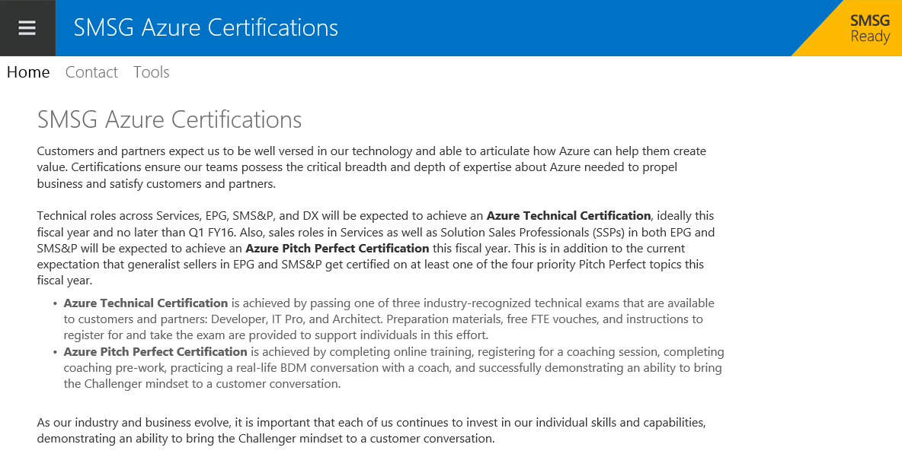
Microsoft Resources
SMSG Azure certification site

Slide 78
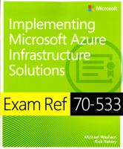
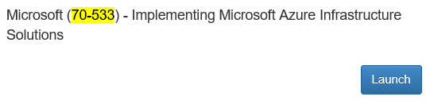
Microsoft Resources Top Sources!
These are the best sources of truth to learn about topics based on the Exam Objectives
Azure Documentation
Azure IaaS for IT Pros Event on Channel 9
MSINVOLVE from TRPP19
Microsoft Azure and the Next Generation of Infrastructure Solutions
Building Hybrid Identity Solutions
Study Resources
MeasureUp Practice Exams!
http://aka.ms/certification/70-533
http://aka.ms/certification/70-534
Instructions how to get it at aka.ms\AzureExamPrep
Microsoft Virtual Academy – Microsoft Azure Courses 44+

Slide 79
Related Content
Certification Sessions
CRT303-R2 REPEAT: Exam prep session on Exam 70-533 –Implementing Microsoft Azure Infrastructure Solutions
Wednesday July 29, 14:30 - 15:45
CRT304-R2 REPEAT: Exam Prep session on Exam 70-534 –Architecting Microsoft Azure Solutions
Wednesday July 29, 16:15 - 17:30

Slide 80
Related Content
Breakout Sessions/Chalk Talks
AZR200 An Overview of Microsoft Azure Networking Capabilities
AZR202 Cloud Identity and Microsoft Tools
AZR215 Introduction to Azure Automation
AZR320 Integrating your on-premise Active Directory with Azure and O365 and beyond
AZR330 Service Fabric Architecture
AZR323 Azure Application Gateway and Network Virtual Appliances
AZR336 Worker Role, VM Scale Sets and 3rd party Compute PaaS
AZRCT303 Azure Service Bus in Action: A Hands-On, Real World Implementation perspective using Event Hubs, Queues and Topics
AZRCT305-R1 ExpressRoute Architecture and Best Practices
AZRCT400 Understanding Azure VM and VNET Troubleshooting - an internal view

Slide 81
Related Content
Hands-On/Instructor Led Labs
AZR200 An Overview of Microsoft Azure Networking Capabilities
AZR202 Cloud Identity and Microsoft Tools
AZR215 Introduction to Azure Automation
AZR320 Integrating your on-premise Active Directory with Azure and O365 and beyond
AZR323 Azure Application Gateway and Network Virtual Appliances
AZR336 Worker Role, VM Scale Sets and 3rd party Compute PaaS
AZRCT305-R1 ExpressRoute Architecture and Best Practices
AZRCT400 Understanding Azure VM and VNET Troubleshooting - an internal view

Slide 82
Session Objectives And Takeaways
Session Objective(s):
Objective 1: Determine how to prepare for Exam 70-534
Objective 2: Recognize areas of design that you might need to brush up on prior to the exam
Objective 3: Learn how to utilize the right study material and a few additional tips & tricks
Key Takeaway 1
Increase participants’ ability to successfully prepare for, and pass, Exam 70-534
Key Takeaway 2
Understand architectural decisions for Microsoft Azure solutions

Slide 83
Q&A
If you have questions please proceed to the Q&A MICROPHONE located in your session room.

Slide 84

© 2015 Microsoft Corporation. All rights reserved. Microsoft, Windows, and other product names are or may be registered trademarks and/or trademarks in the U.S. and/or other countries.
The information herein is for informational purposes only and represents the current view of Microsoft Corporation as of the date of this presentation. Because Microsoft must respond to changing market conditions, it should not be interpreted to be a commitment on the part of Microsoft, and Microsoft cannot guarantee the accuracy of any information provided after the date of this presentation. MICROSOFT MAKES NO WARRANTIES, EXPRESS, IMPLIED OR STATUTORY, AS TO THE INFORMATION IN THIS PRESENTATION.

